Slide 1
Benchmarking and Evaluating Uncorrelated Track Processing Algorithms
Louis Caves, Gabriel Lundin, Binyamin Stivi, Miles Puchner
, AFRL SCHOLARS PROGRAM INTERN
Graduate LEVEL
SDA TAP Lab, SUMMER 2025
“DISTRIBUTION C – Distribution authorized to U.S. Government Agencies and their contractors; Technical content. July 15, 2025.”

Slide 2

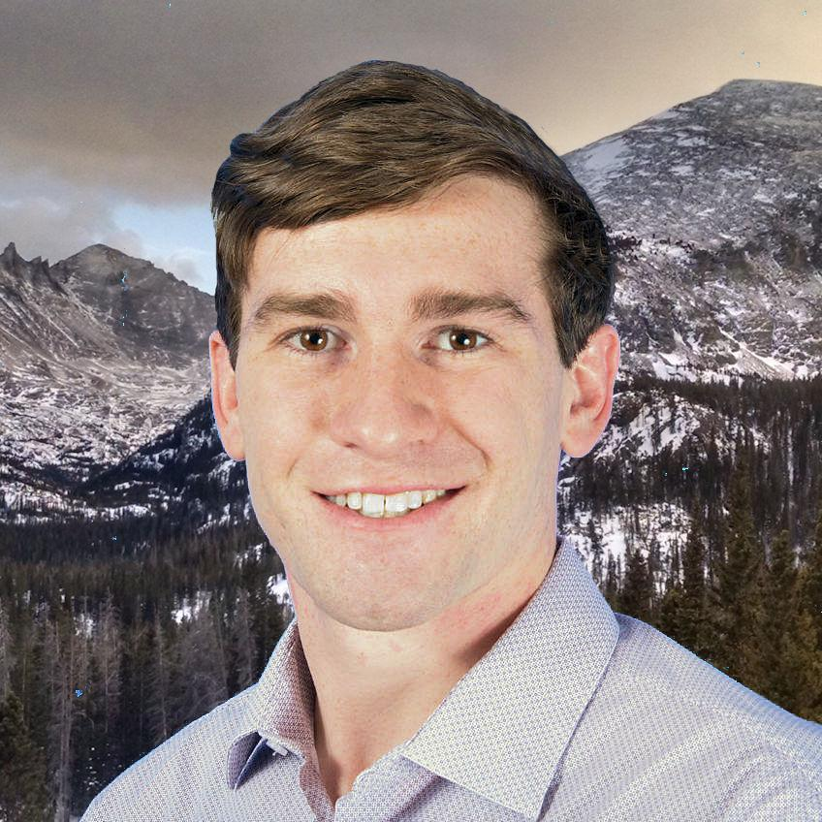

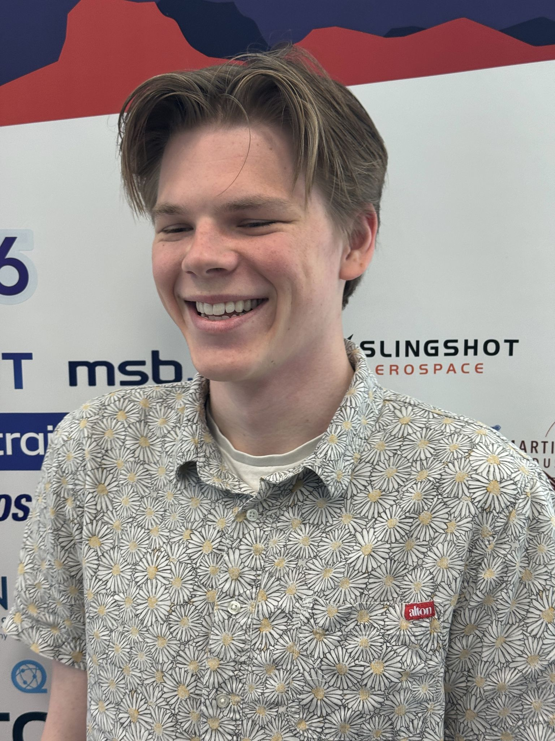
Introduction
Louis Caves University at Buffalo, New York B.S/M.S. Experimental Physics M.S. Aerospace Engineering louiscaves@gmail.com | Gabriel Lundin Texas A&M University B.S. Aerospace Engineering University of Minnesota Ph.D. Aerospace Engineering (expected) glundin76@gmail.com
Binyamin Stivi University of California, San Diego B.S/M.S Aerospace Engineering Masters student working on thesis binyamin.stivi@gmail.com | Miles Puchner University of California, San Diego B.S/M.S Aerospace Engineering Incoming Masters student milespuchner@gmail.com
“DISTRIBUTION C – Distribution authorized to U.S. Government Agencies and their contractors; Technical content. July 15, 2025.”

Slide 3
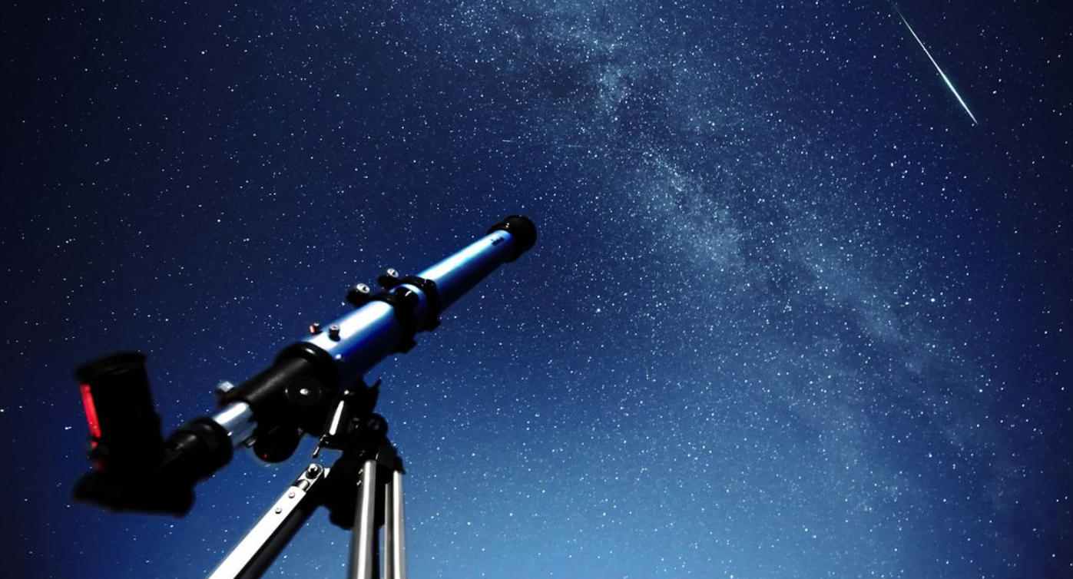
Uncorrelated Tracks (UCT) – What they are and why they matter
Do we know what this is?
Retrieved from: https://cdn.mos.cms.futurecdn.net/rU2TmB5aH6Uafd6sigNMeX-1200-80.jpg (July 2025)
“DISTRIBUTION C – Distribution authorized to U.S. Government Agencies and their contractors; Technical content. July 15, 2025.”
Notes:
Measurement devices such as telescopes, radar, passive RF, etc. scan the sky for RSOs. Object will appear as a track, seen in the image When an object if found, its location is cross-referenced against a catalogue of known objects. Sometimes, the tracks do not correlate to any known objects. These are referred to as Uncorrelated Tracks, or UCTs. UCTs present an issue for SDA because it represents an object in space that we don’t know what it is. It might pose a threat to our space infrastructure.

Slide 4
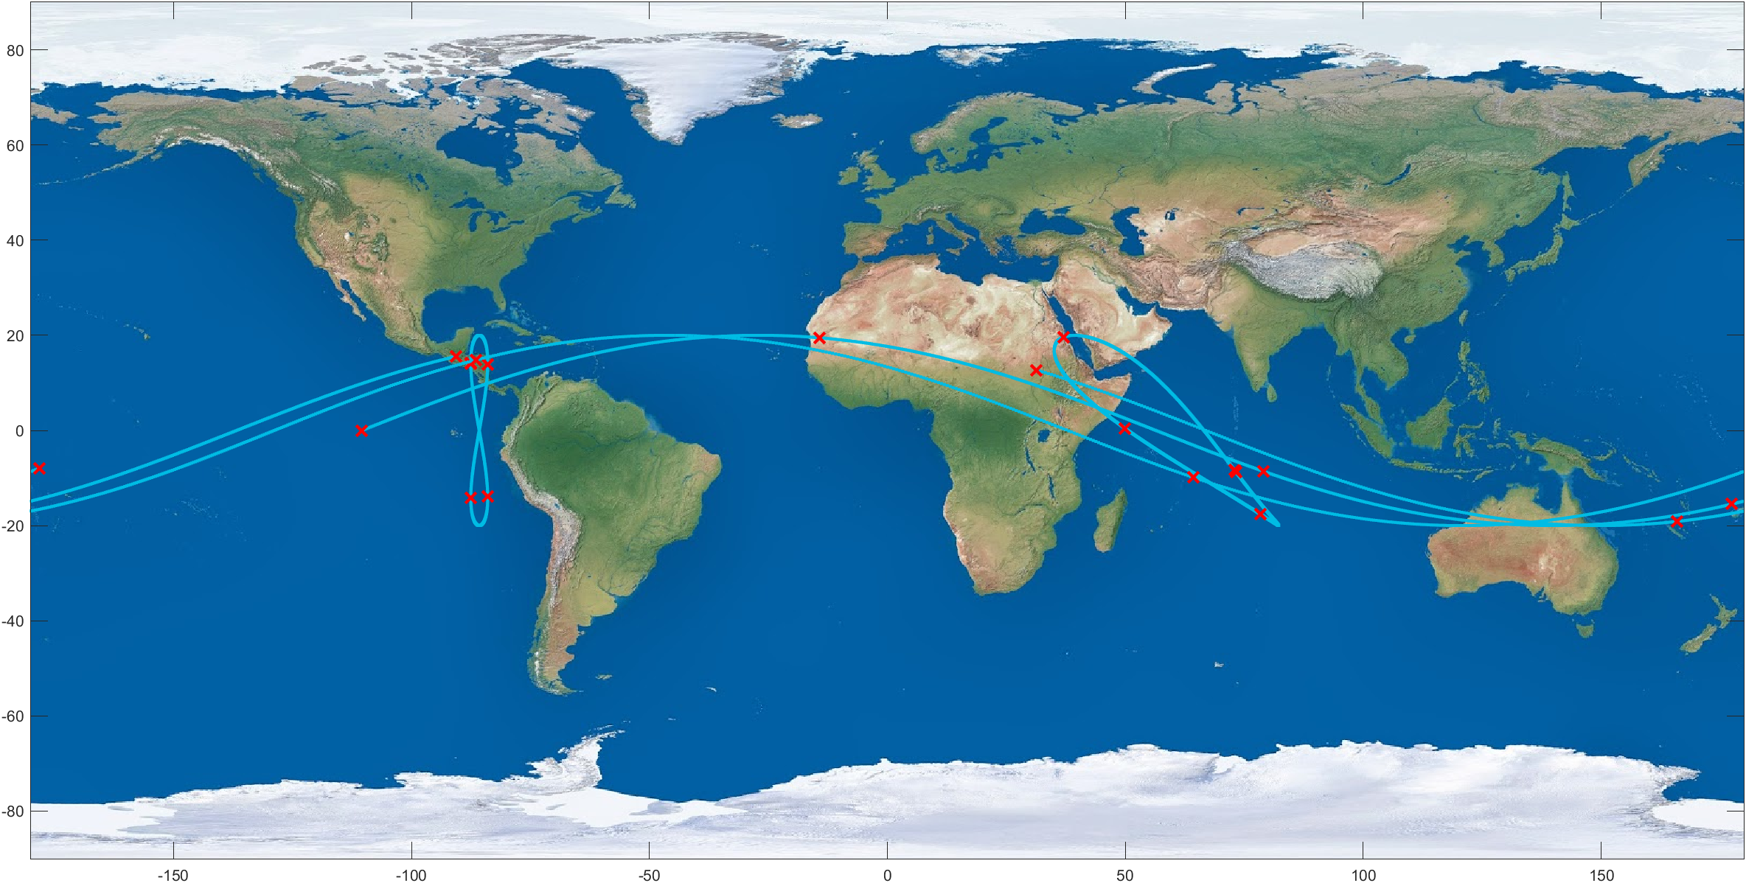
Uncorrelated Track Processing (UCTP)
Inputs:
List of UCTs
Outputs:
Orbital Estimate
List of observations corresponding to that orbit
“DISTRIBUTION C – Distribution authorized to U.S. Government Agencies and their contractors; Technical content. July 15, 2025.”
Notes:
Ground Traces shown is only 4 satellites, and already there are many observations that lie on top of eachother. It's obvious to see how this is a difficult problem to solve, but there is a separate, more nuanced issue associated with UCT processing. When someone presents a UCT solution, how do we know how accurate it is? By definition, there is no known solution to compare to.

Slide 5
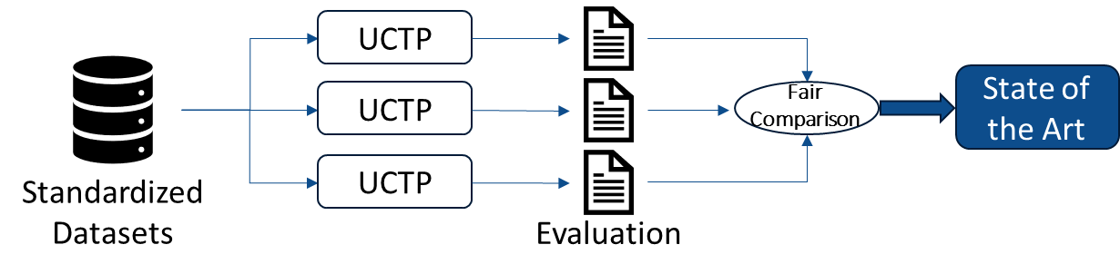
Benchmarking and Evaluation - The Common Task Framework
A common task framework has three components
“A publicly available training dataset involving, for each observation, a list of (possibly many) feature measurements, and a class label for that observation
A set of enrolled competitors whose common task is to infer a class prediction rule from the training data
A scoring referee, to which competitors can submit their prediction rule. The referee runs the prediction rule against a testing dataset which is sequestered behind a Chinese wall. The referee objectively and automatically reports the score (prediction accuracy) achieved by the submitted rule.”
- David Donoho. 50 Years of Data Science. September 2015
“DISTRIBUTION C – Distribution authorized to U.S. Government Agencies and their contractors; Technical content. July 15, 2025.”
Notes:
The Common task framework is a structured method for evaluating and comparing different solutions to the same problem. CTF commonly used in data science, machine learning/AI, image recognition, etc. to accelerate advancements in state-of-the-art. As defined by Donoho in landmark paper 50 years of data science, CTF has …. We want to bring elements of the CTF to SDA, by providing an objective way to evaluate performance of different predictive algorithms, and highlight where these algorithms are deficient/identify where they need to improve. Our specific task for this summer was to benchmark and evaluate UCT processing algorithms, with the idea being to create the framework to be generalized to other areas of SDA.

Slide 6
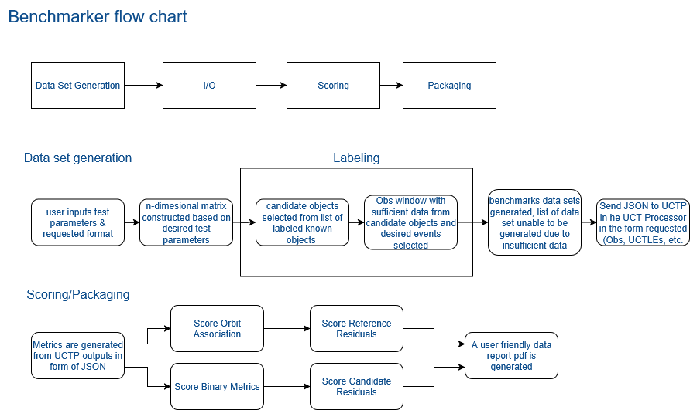
Benchmark Structure
“DISTRIBUTION C – Distribution authorized to U.S. Government Agencies and their contractors; Technical content. July 15, 2025.”

Slide 7
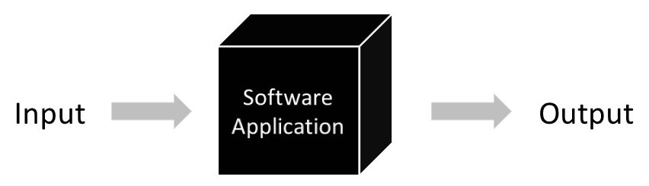
Challenges of a UCTP Benchmark
UCTP has to be treated as a “black box”
Benchmark must be as universal as possible
UCTP Benchmark must be able to give any standard of inputs and objectively grade any standard of outputs
Available data is sporadic, dependant on accessibility, and incomplete
Datasets are heavily time-dependant
Retrieved from: https://www.testbirds.com/en/blog/black-box-testing-enhancing-user-experience/ (July 2025)
“DISTRIBUTION C – Distribution authorized to U.S. Government Agencies and their contractors; Technical content. July 15, 2025.”
Notes:
UCTP are often Proprietary
UCTP inputs can take two main forms
Raw Observations (Optical, Radar Tracks, RF)
Uncorrelated Two Line Elements (Track TLEs)
UCTP outputs can take 3 main forms
Correlated Observations
Correlated State Vector
Correlated TLE

Slide 8
Data Set Generation
“DISTRIBUTION C – Distribution authorized to U.S. Government Agencies and their contractors; Technical content. July 15, 2025.”

Slide 9
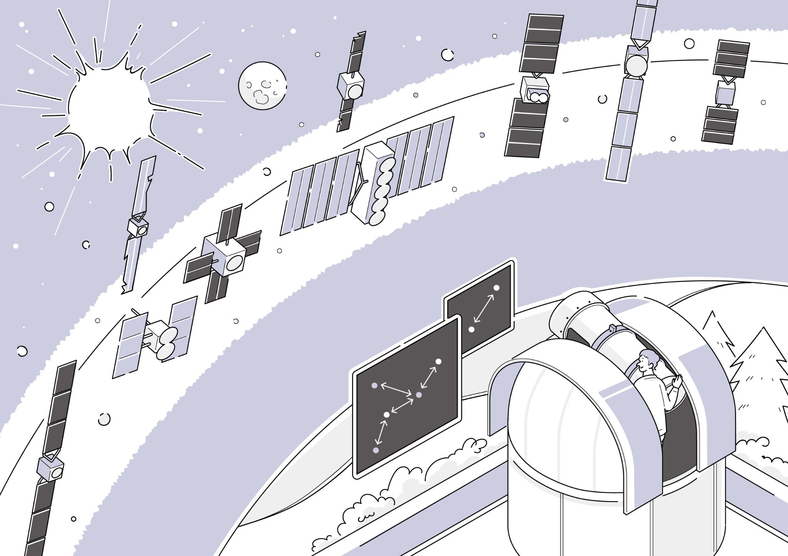
Terminology
TrackTLE: TLE (Two Line Element) generated by performing initial orbit determination on a single track of observations. These are used in the benchmark datasets to emulate UCT TLEs
Reference Object: Satellite with known NORAD ID, state vector, TLE, and list of observations publicly available on the UDL that are made a part of a benchmark dataset.
Reference Orbit: State Vector, TLE, a list of observations, and a list of trackTLEs generated from the list of observations that are associated with a Reference Object.
Candidate Orbit: Output generated by the UCTP, defined by a Candidate State Vector and epoch or Candidate TLE, along with a list of observation IDs or trackTLE IDs the UCTP has correlated to that state vector or TLE.
Common Epoch: The epoch in which the Candidate Orbit state vector or TLE is generated.
Retrieved from: https://www2.nict.go.jp/wireless/en/i_orbit.html (July 2025)

Slide 10
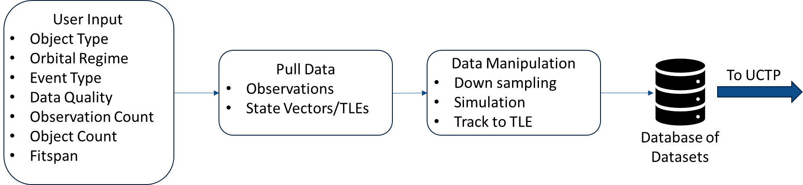
Dataset Generation Workflow
“DISTRIBUTION C – Distribution authorized to U.S. Government Agencies and their contractors; Technical content. July 15, 2025.”
Notes:
Basic dataset generation workflow, we first allow the user, whether it is the developer of UCTP or a 3rd party evaluator, to select the desired characteristic of the dataset used to test. There are different options, such as object type, orbital regime, and data quality. We then go find the data that best matches the user-defined specifications, which becomes our reference objects and reference orbits, and perform any data manipulation necessary. If there is too much data and the user desires a sparser dataset, we will selectively downsample the data. If there is too little data, we will simulate observations to achieve the desired result. We will also convert the raw observations to trackTLEs. All of that information is then saved as the benchmark dataset, which is saved in a database. Any one of these datasets is then what is fed into the UCTP.

Slide 11
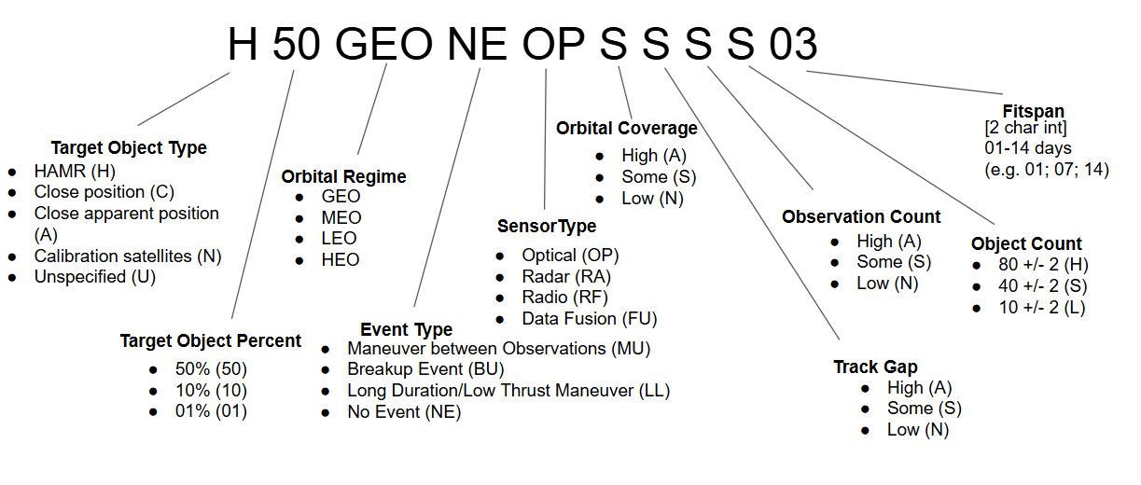
User Input - Dataset Code
“DISTRIBUTION C – Distribution authorized to U.S. Government Agencies and their contractors; Technical content. July 15, 2025.”
Notes:
Dataset code is a unique 16 character string encoding the user selected data parameters.

Slide 12

Unified Data Library
UDL contains data collected from various public/private sources
Available data includes TLEs, raw observations (RA/Dec), state vectors with covariance, etc.
Built-in API allows for automated dataset updates
Used known catalogued satellite data from UDL as “truth” reference
Data is de-correlated to simulate UCT data before being fed to the UCTPs
Reference is stored in answer key for later evaluation
Retrieved from: https://catalystcampus.org/programs/ (July 2025)
“DISTRIBUTION C – Distribution authorized to U.S. Government Agencies and their contractors; Technical content. July 15, 2025.”

Slide 13

Python & Orekit
For sake of transparency, benchmark needs to be open source.
We decided to use the open source Orekit Python Wrapper
Orekit has built-in coordinate frame conversion
It's an academic and industry standard
Easy to build a Propagator suited for us
More info at https://www.orekit.org/
Retrieved from: https://newspace-factory.com/product/orekit/ (July 2025)
“DISTRIBUTION C – Distribution authorized to U.S. Government Agencies and their contractors; Technical content. July 15, 2025.”
Notes:
Orekit has built-in unit conversion that makes dealing with the different standards seen in the UDL easier

Slide 14
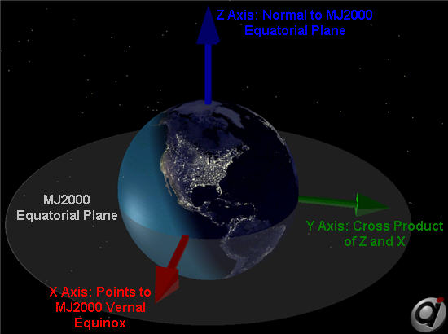
Establish Standard Epoch & Coordinate Frame
States from UDL can come in several different Coordinate Systems & Epochs
All Data from the UDL is converted to use the J2000 frame and UTC time.
Utilize Orekit’s built in Frame Conversion for both states and Covariances
Retrieved from: https://ai-solutions.com/_help_Files/orbit_reference_frames.html (July 2025)
“DISTRIBUTION C – Distribution authorized to U.S. Government Agencies and their contractors; Technical content. July 15, 2025.”
Notes:
(TEME, GCRF, ITRF, ECEF, TDR, J2000)
(UTC, JD, MJD) All observation data from the UDL are assumed to be in J2000 and UTC time as no other standard has been seen in the UDL

Slide 15
Window Selection - Dataset Culling and Recycling
Allowing for a variety of dataset options may lead the user to choose incompatible criteria for dataset generation
e.g. desiring a 2 period track gap for a GEO object in a data window of less than 2 days is not possible
Incompatible dataset codes must either be culled entirely or flagged for simulation
Standardized naming schema (dataset codes) allows for ease of dataset recycling in specific cases
e.g. ‘A 10 MEO NE OR A A A S 02’ can be recycled from ‘A 20 MEO NE OR A A A S 02’ by downsampling the number of close apparent position target objects (A) from 20% to 10%
Querying the UDL takes significant time; recycling datasets avoids this inconvenience wherever possible
Datasets for codes identical to those that have already been created are also recycled by pulling the dataset from a saved database
“DISTRIBUTION C – Distribution authorized to U.S. Government Agencies and their contractors; Technical content. July 15, 2025.”

Slide 16
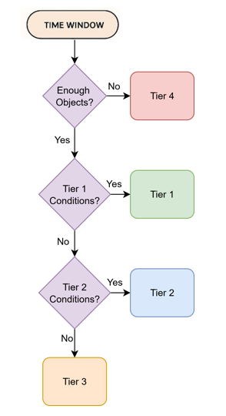
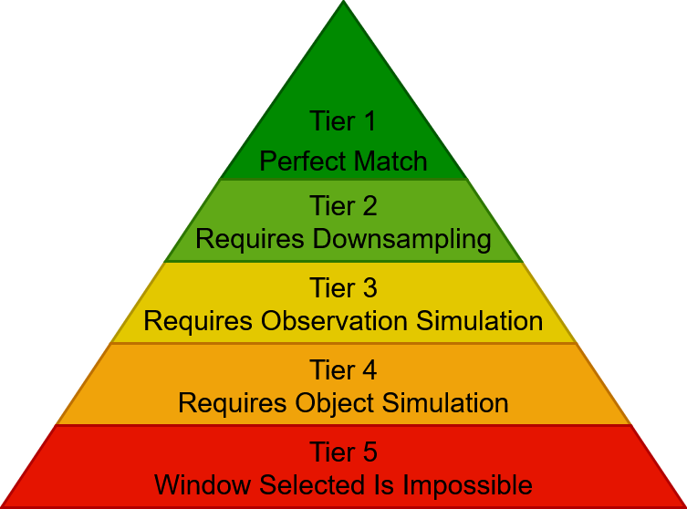
Window Selection - Scoring
“DISTRIBUTION C – Distribution authorized to U.S. Government Agencies and their contractors; Technical content. July 15, 2025.”
Notes:
Tier conditions: Observation Count, Track Gap, Orbit Coverage

Slide 17
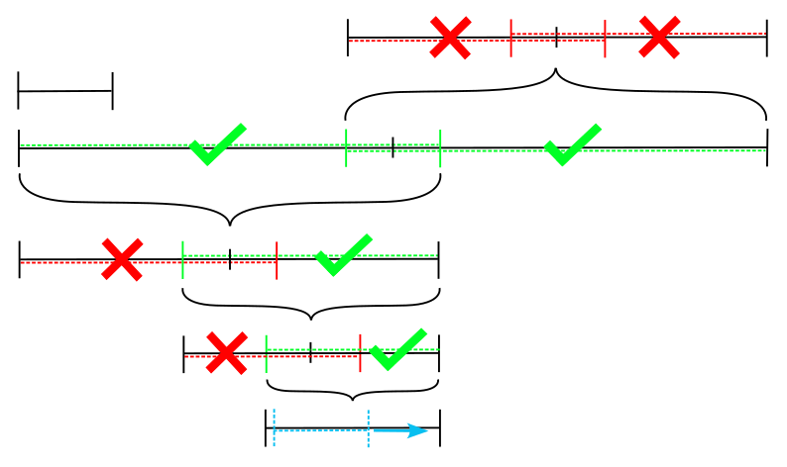
Window Selection - Main Algorithm
Pulls “batches” of data over a timespan equal to a multiple of the user specified fitspan
Utilizes overlapping bisection method
Overlap must be, at least, half the fitspan on either side of bisection midpoint to avoid data loss
Recursively bisects into “sub-batches” and scores the data for target tier comparison
Employs a sliding window once valid “sub-batches” are sufficiently small
Slides per data point to ensure no loss of data or suboptimal grouping
“DISTRIBUTION C – Distribution authorized to U.S. Government Agencies and their contractors; Technical content. July 15, 2025.”

Slide 18
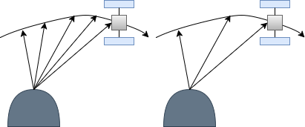
Downsampling
Simulate poor data quality from good measurements by removing observations
Metrics:
Orbital Coverage
Satellites have < 0.02-42% coverage
Addresses minimal viewing window
Maximum Track Gap
Gap between observations > 2 Periods
Addresses lack of custody
Total Observation Count
< 50 observations of the satellite
Addresses sparse tracking data
“DISTRIBUTION C – Distribution authorized to U.S. Government Agencies and their contractors; Technical content. July 15, 2025.”

Slide 19
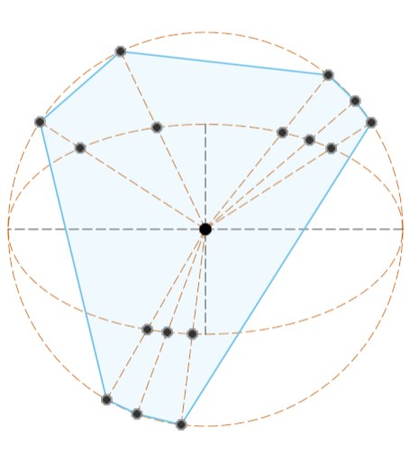
Orbital Coverage Metric
Why?:
Standard coverage: Angular track length
Hard to quantify in real data
Developed new method using area
Algorithm:
Closest-approach of observations to orbit
Removes observation noise
Project observations to circumscribed circle
Removes eccentricity dependency
Draw polygon using projections as vertices
Find area of polygon
Heavily prioritizes scattered observations
Normalize by area of circle
Orbit coverage% !
“DISTRIBUTION C – Distribution authorized to U.S. Government Agencies and their contractors; Technical content. July 15, 2025.”

Slide 20
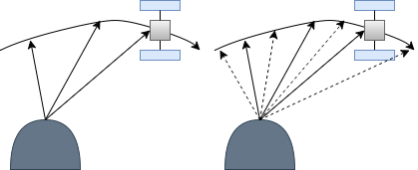
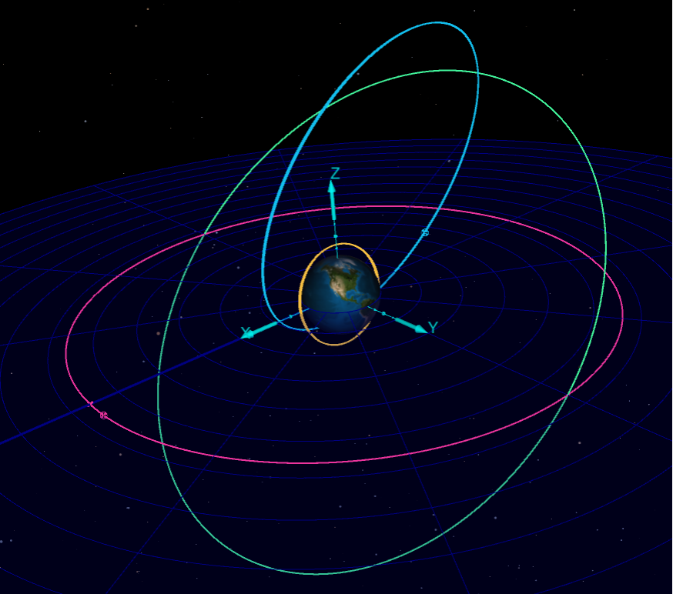
Simulation
Observation Simulation
Applies Gaussian noise to both the propagated positions and converted right ascension and declination values
Determines simulated azimuth and elevation values from the simulated angular values and known site locations (lat, lon, alt)
Object Simulation
Simulates a set of observations for a specific object originally not included
Retrieved from: https://etd.gsfc.nasa.gov/capabilities/capabilities-listing/general-mission-analysis-tool-gmat/ (July 2025)
“DISTRIBUTION C – Distribution authorized to U.S. Government Agencies and their contractors; Technical content. July 15, 2025.”
Notes:
Similar but opposite to downsampling is simulation. The same way that we downsample data to fit the desired orbital coverage, track gap, and observation count, simulation may also be necessary to fit these specifications. We will take the state vector of the reference orbit and propagate to the observation epoch. Gaussian noise is then added to all three position components, and the inertial position is converted into a RA/dec. We then chose an observatory from a list of observatories that are most common on the UDL to simulate the observation from, and convert the RA/dec to az/el, thus emulating the angles only measurement one could expect from an optical telescope.

Slide 21
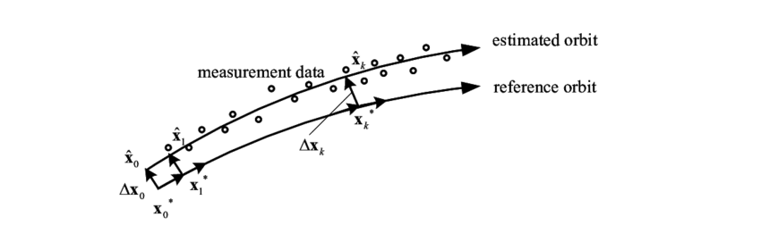
Track to TLE Generation
Some UCTPs use uncorrelated TLEs
UDL TLEs insufficient due to their high accuracy
Using a Modified Gauss Method & Batch Filter, Uncorrelated Tracks from the UDL are turned into TLEs
Retrieved from: https://www.researchgate.net/figure/The-batch-least-squares-estimation-Then-the-nonlinear-orbit-determination-problem-can-be_fig2_310334667 (July 2025)
“DISTRIBUTION C – Distribution authorized to U.S. Government Agencies and their contractors; Technical content. July 15, 2025.”
Notes:
uncorrelated TLEs made from uncorrelated Tracks from one observatory
High accuracy from multiple Observers

Slide 22
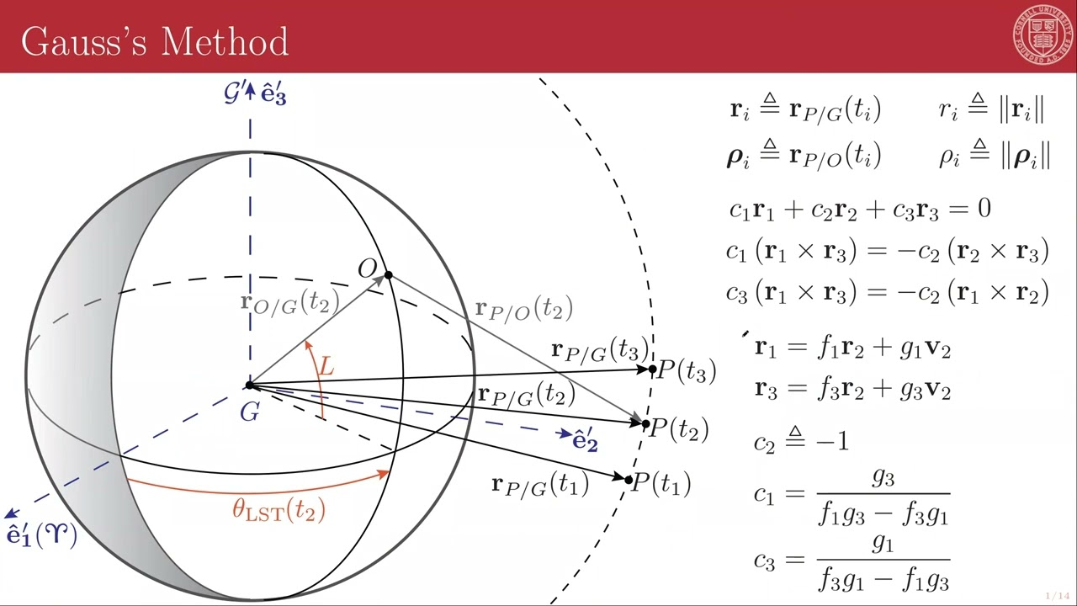
Modified Gauss Method
Standard Gauss IOD that determines the three position vectors from three angular observations
Attempts to create triplets of observations with angular separations between 1 and 30 degrees
Uses Gibbs or Herrick-Gibbs method to determine the velocity at the middle epoch
Refines state vector by updating position vectors based on residuals from Lagrange coefficient propagation (f and g functions)
Culls states with semimajor axes outside +/- 25% of the standard deviation from the mean
Retrieved from: Dr. Shane Ross (July 2025)
“DISTRIBUTION C – Distribution authorized to U.S. Government Agencies and their contractors; Technical content. July 15, 2025.”

Slide 23
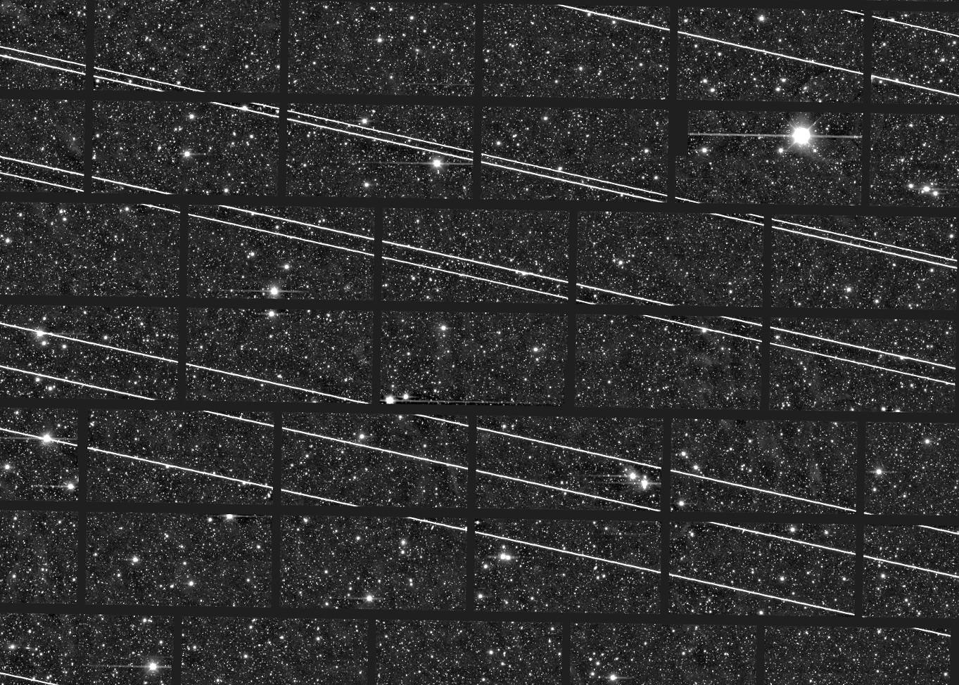
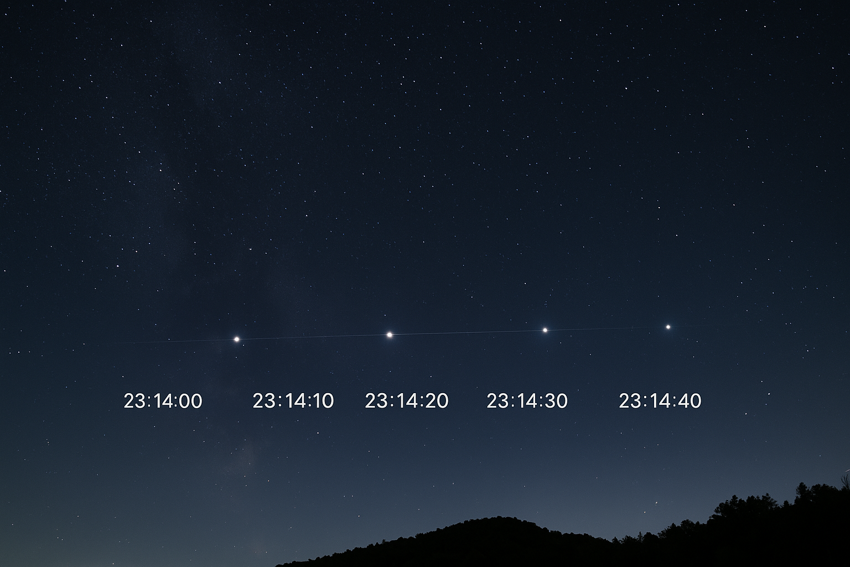
Data Manipulation: Bin & Sort Observations
Observations and states are first added to an answer key
They are then stripped of identifying Norad IDs so that UCTP cannot cheat
The Observations are then grouped by their passes over observatories
Most providers do not provide this information; bin manually
In the field, Uncorrelated Observations aren’t completely “uncorrelated”
Retrieved from: https://www.lsst.org/content/lsst-statement-regarding-increased-deployment-satellite-constellations (July 2025)
Retrieved from: ChatGPT (July 2025)
“DISTRIBUTION C – Distribution authorized to U.S. Government Agencies and their contractors; Technical content. July 15, 2025.”
Notes:
Utilizing Pandas Dataframes

Slide 24
Evaluation/Packaging
“DISTRIBUTION C – Distribution authorized to U.S. Government Agencies and their contractors; Technical content. July 15, 2025.”

Slide 25
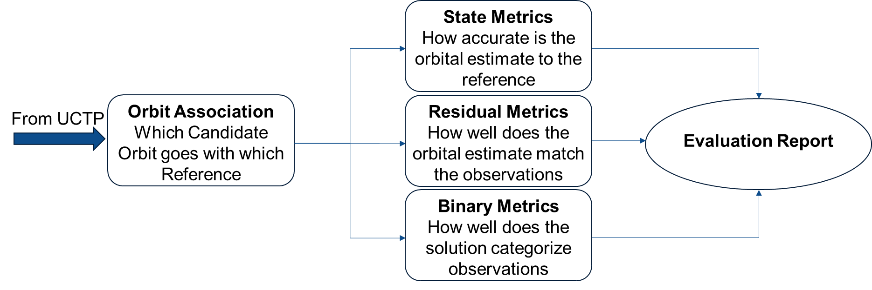
Evaluation Workflow
“DISTRIBUTION C – Distribution authorized to U.S. Government Agencies and their contractors; Technical content. July 15, 2025.”
Notes:
segue into force model

Slide 26
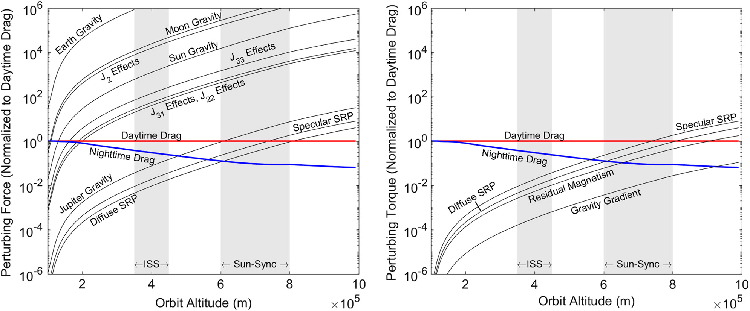
Force Model Specifics
The Force Model used here was verified with GMAT and ODTK
Earth Gravity and Harmonics (Up to J₁₂₀)
Point mass Gravity from the Moon and Sun
Cannonball model drag using NRLMSISE00 atmosphere model
Cannonball model solar radiation pressure with ecclipting Earth
Numerically Integrated with Runge Kutta 8(5,3)
Retrieved from: https://arc.aiaa.org/doi/10.2514/1.A34338 (July 2025)
“DISTRIBUTION C – Distribution authorized to U.S. Government Agencies and their contractors; Technical content. July 15, 2025.”

Slide 27
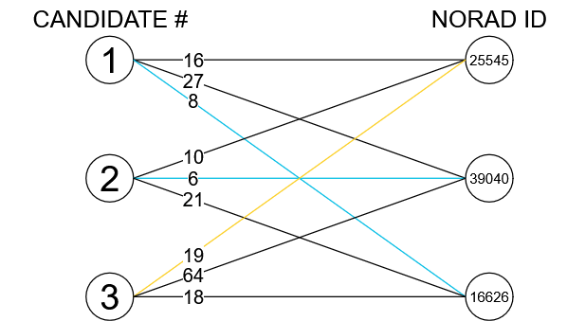
Orbit Association
Assume the UCTP does not check objects vs catalog
Need to “match” candidate results to references
Use Hungarian Algorithm (scipy.optimize.linear_sum_assignment)
Minimize norm of error vector
Created using drawio.com
“DISTRIBUTION C – Distribution authorized to U.S. Government Agencies and their contractors; Technical content. July 15, 2025.”

Slide 28
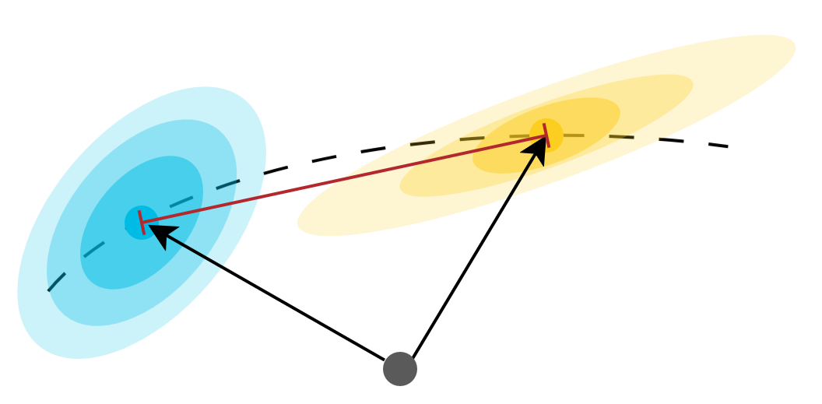
State Metrics
Propagate each reference to candidate and compare state vectors
Error Norm: How physically close are the vectors?
Bias: Is the UCTP candidate off in a consistent manner?
Mahalanobis P-score: How likely is it that the vectors correspond to the same orbit?
Normalized Estimation Error Squared: How confident is the processor in its results?
Created using drawio.com
“DISTRIBUTION C – Distribution authorized to U.S. Government Agencies and their contractors; Technical content. July 15, 2025.”
Notes:
MILES STARTS

Slide 29
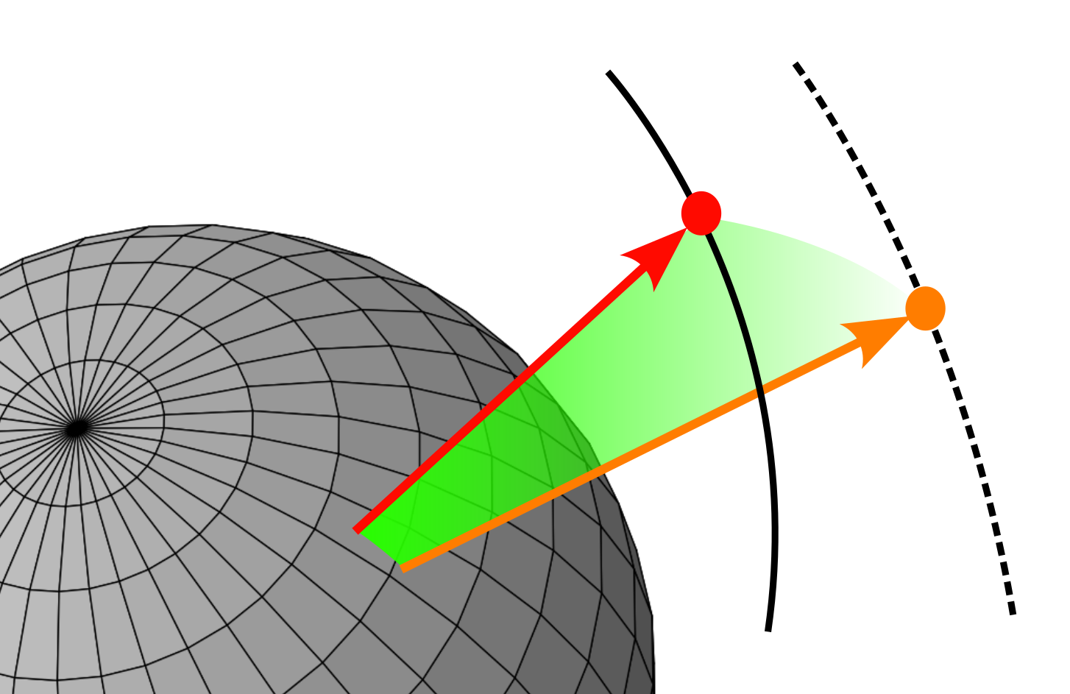
Residual Metrics
Computes the unit circle great arc residual between two sets of angular observations
Gives a measure for the accuracy and precision of the UCTP
Accuracy: compares the reference orbit observations / trackTLEs with the UCTP candidate orbital estimation
Precision: compares the UCTP candidate orbit observations / trackTLEs with the UCTP candidate orbital estimation
“DISTRIBUTION C – Distribution authorized to U.S. Government Agencies and their contractors; Technical content. July 15, 2025.”

Slide 30
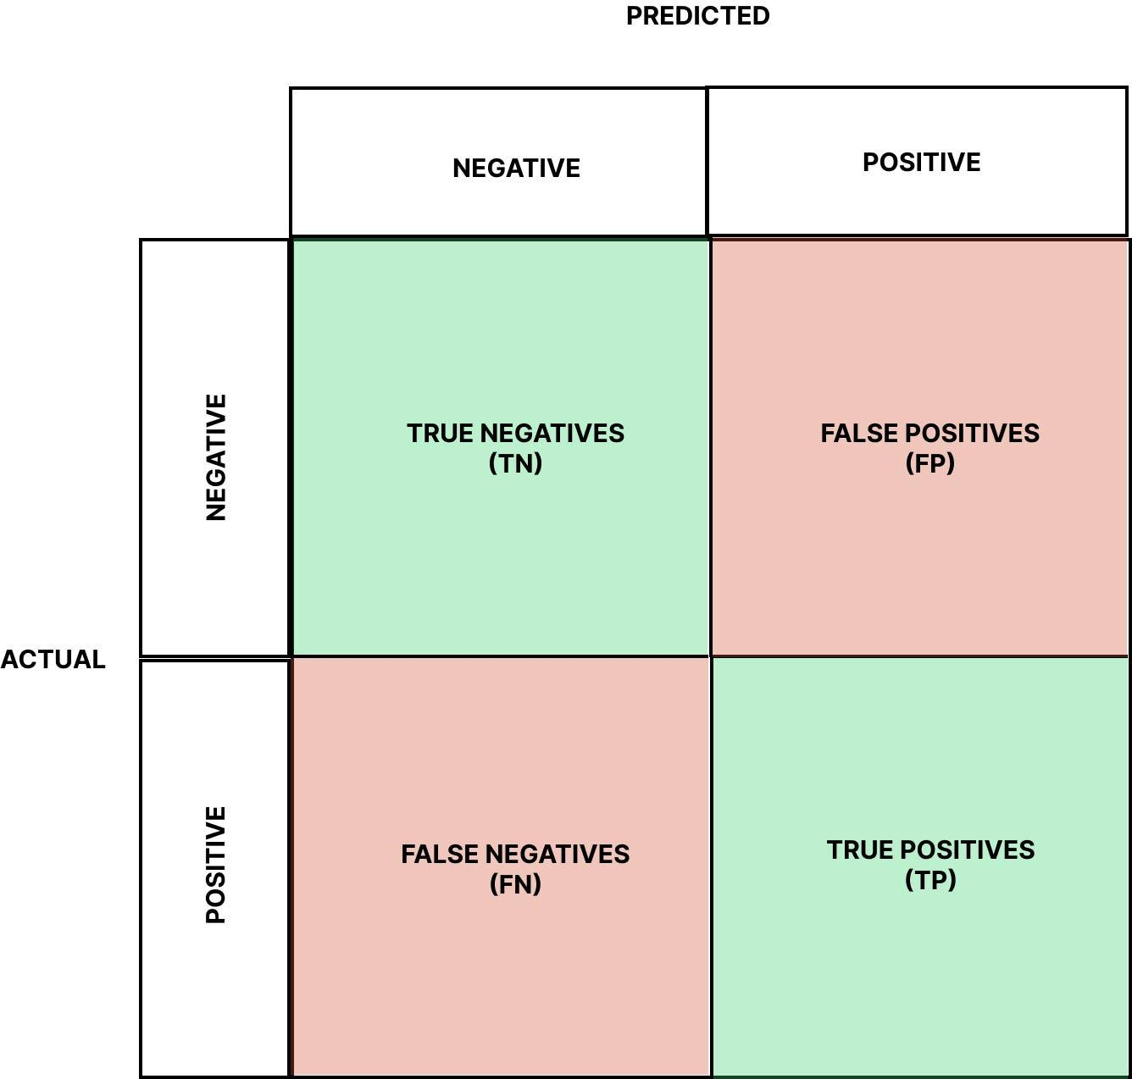
Binary Metrics
True Positive (TP): Observation or TrackTLE belongs to both the Candidate Orbit and the Reference Orbit to which it has been associated
True Negative (TN): Observation or TrackTLE does not belong to any Candidate Orbit or Reference Orbit
False Positive (FP): Observation or TrackTLE belongs to a Candidate Orbit but not the Reference Orbit
False Negative (FN): Observation or TrackTLE does not belong to a Candidate Orbit but does belong to the Reference Orbit
Retrieved from: https://medium.com/data-science/the-explanation-you-need-on-binary-classification-metrics-321d280b590f (July 2025)
“DISTRIBUTION C – Distribution authorized to U.S. Government Agencies and their contractors; Technical content. July 15, 2025.”
Notes:
Observations can be classified in one of four categories, depending on if they were associated correctly or incorrectly. A True positive is when an observation is correctly associated with the appropriate reference object. A true negative is when an observation is correctly not associated with any reference object. A False positive is when an observation is incorrectly associated with a reference object, and a false negative is when an observation is incorrectly not associated with any reference object.
True Positive (TP): Observation or TrackTLE belongs to both the Candidate Orbit and the Reference Orbit to which it has been associated
True Negative (TN): Observation or TrackTLE does not belong to any Candidate Orbit or Reference Orbit
False Positive (FP): Observation or TrackTLE belongs to a Candidate Orbit but not the Reference Orbit to which it has been associated
False Negative (FN): Observation or TrackTLE does not belong to a Candidate Orbit but does belong to the Reference Orbit to which it has been associated
Compare The Observations/TrackTLEs associated by the UCTP
Leads to many more secondary values used to classify the results:
F1 Score
Cohen’s Kappa Coefficient
Matthews Correlation Coefficient

Slide 31
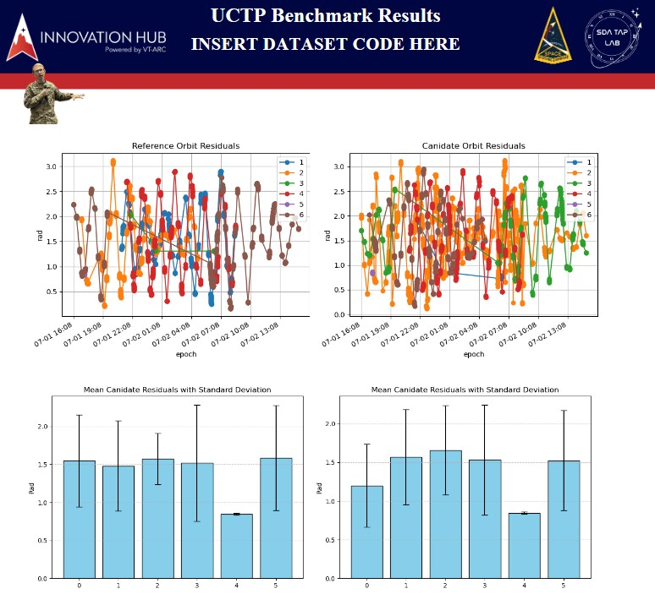
Final PDF Report
All Relevant Scoring is visualized in final PDF report
Dataset Code on top allows UCTP to easily identification
2 Versions of final PDF report: State Metrics & TLE
Capable of automatically growing in size to accommodate larger Datasets
“DISTRIBUTION C – Distribution authorized to U.S. Government Agencies and their contractors; Technical content. July 15, 2025.”

Slide 32

Test Case: Aerospace Corp. UCTP
Developed by Felix Hoots and Bob Morris
Written in Fortran
Takes in observations organized by tracks
Industry Leading
Retrieved from: https://aerospace.org/ (July 2025)
“DISTRIBUTION C – Distribution authorized to U.S. Government Agencies and their contractors; Technical content. July 15, 2025.”

Slide 33
Challenges & Future Work
“DISTRIBUTION C – Distribution authorized to U.S. Government Agencies and their contractors; Technical content. July 15, 2025.”

Slide 34

Room for Improvement
TLE Generation is very computationally expensive and must be run with every new dataset
Develop physically accurate noise for data simulation
Final PDF Report needs to be expanded to include more Graphs to better illustrate results
Need more testing with real UCTPs to calibrate scoring and datasets
Expand beyond optical observations (requires clearance)
Retrieved from: https://professionalandtechnicalwriting.wordpress.com/2020/02/17/engineering-design-process/ (July 2025)
“DISTRIBUTION C – Distribution authorized to U.S. Government Agencies and their contractors; Technical content. July 15, 2025.”
Notes:
current trakcTLE generation algorithm is computationally expensive, could propaby be made more efficient
Add additional object types - close apparent position/ close apparent magnitude
More realistic noise conditions for simulation - USAFA cadet working with us did some great research into physically realistic sources of uncertainty of EO Obs, has not yet been integrated into our existing simulation architecture
Verification data from UCTPs

Slide 35
Future Plans
Currently Documenting all processes for next cohort of Interns
Implement Orbit events by coordinating with labelling team
Implement object types of interest to SDA community
Migrate code to run server side
Integrate with Lawrence Livermore Front end UI
Advertise UCTP benchmark in Academia & Industry
“DISTRIBUTION C – Distribution authorized to U.S. Government Agencies and their contractors; Technical content. July 15, 2025.”
Notes:
We are rigorously documenting or processes, research challenges, and future research plans in a transition document to pass off to whomever would like to improve on this process after our internship ends. A brief summary of what is left to be implemented includes:
The internship group sponsored by the DIU working alongside us has been working on curating a labeled database of events of interest to the space community, such as attitude changes, orbital maneuvers, proximity events, breakup events, and more. We need to integrate these two projects to allow for a framework to benchmark UCTPs that can accurately identify these types of events
Implement specific object types of interest that have proven difficult for UCTPs, such as objects with close apparent position or similar visual magnitude.
Currently all of our code is being run on local machines, we need to migrate our code base to run on remote servers or cloud commute resources so it can be more accessible.
LLNL has a front-end UI (need to get specifics of this)
Once the pipeline is fully automated and integrated with a UI, it needs to be advertised to academia and industry partners

Slide 36
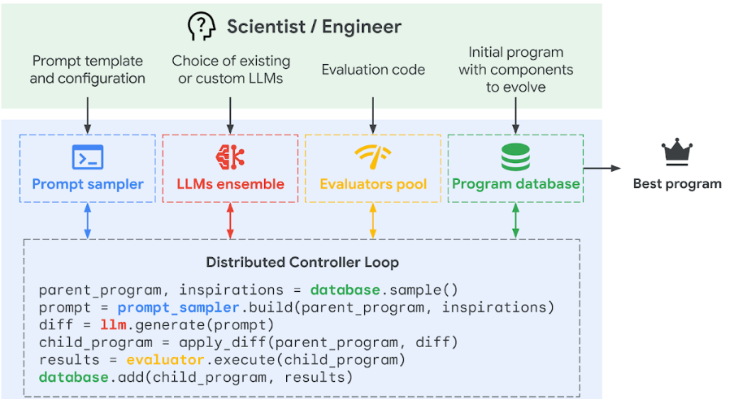
UCT Processing and OpenEvolve
Retrieved from: https://deepmind.google/discover/blog/alphaevolve-a-gemini-powered-coding-agent-for-designing-advanced-algorithms/
“DISTRIBUTION C – Distribution authorized to U.S. Government Agencies and their contractors; Technical content. July 15, 2025.”
Notes:
Google Deep Mind has developed a new AI agent for optimizing coding applications through an iterative process of querying LLM models via API based on a user defined prompt to suggest improvements to a given function. The suggested improvements are then evaluated against some user-defined scoring metrics to determine whether improvements were actually made, and the best function at every iteration is saved to be the new target of improvement. After many iterations of manipulation and evaluation, an optimized ‘best program’ is output by the software. Google Deep Mind has already demonstrated success with AlphaEvolve, improving current state-of-the-art for certain classes of matrix multiplication algorithms.
There is an open-source version of AlphaEvolve, called OpenEvolve, which works in a very similar way. It is intended to use our benchmarking and evaluation pipeline in the evaluation function required by the OpenEvolve architecture and attempt to iterate on existing UCTP algorithms to identify areas of improvement for current state-of-the-art to enhance SDA capabilities.

Slide 37
References
[1] Donaho, D. 50 Years of Data Science. September 2015
[2] D. A. Vallado, Fundamentals of Astrodynamics and Applications. Hawthorne, CA. Microcosm Press, 2013
[3] SDA Tap Lab, “The need to benchmark uncorrelated track (UCT) processing,” LinkedIn, https://www.linkedin.com/pulse/need-benchmark-uncorrelated-track-uct-processing-sdataplab-nnkvc/ (accessed Jul. 24, 2025).
“DISTRIBUTION C – Distribution authorized to U.S. Government Agencies and their contractors; Technical content. July 15, 2025.”

Slide 38
Thank you for Listening
“DISTRIBUTION C – Distribution authorized to U.S. Government Agencies and their contractors; Technical content. July 15, 2025.”

Slide 39
Space Event Data Labeling
Ground truth is essential for reliable algorithms and machine learning operations that look to characterize space events
NOTSO notifications (Notice to Space Operators) assist us building standardized datasets to assist in this endeavor
Our pipeline to takes these text-heavy, human-entered events and provides a space event label and builds time event window to gather observation data that is associated with the event
Future engineers will use this packaged data to train algorithms to classify, detect, and characterize events in space
“DISTRIBUTION C – Distribution authorized to U.S. Government Agencies and their contractors; Technical content. July 15, 2025.”
Notes:
Finding ground truth in space is very hard to do for a multitude of reasons; noisy sensor data, fragmentation of observations and reporting, data silos and confidentiality, lack of standardization and continuity of defining space events. If we intend to tackle the characterization, detection, and classification of space events using machine learning, finding a way to derive some truth from the ground truth data we do have is essential.
NOTSOs (Notice to Space Operators) are notifications from the Joint Commercial Operations that state when a known entity or entities has done something; made a maneuver, executed a rendezvous, created a breakup, launched from from a particular site. Right now this one of the most reliable sources reporting events that happen in space.
The problem is that these notifications are text-heavy, human-entered, semantically-rich and have a large amount of variance in how each type of event is reported over time, and is most likely to change in the future.
Our pipeline uses a combination of natural language processing (text classification) and software engineering to extract insights from the text-heavy event such as date/times, satellite numbers an provides the event with one of the 82 space event labels curated by subject matter experts the space domain.
From there we are able to build a time window around that event which is used to gather observation data that will assist in contextualizing the event. All of this data is then packaged and formatted for space operators.
The value of this is that future engineers now have labeled ground truth data which can be used train algorithms to characterize, classify, and detect events in space.
My team will be giving a full length presentation on this topic August 6th if you are interested in learning more about the project

